Slide 1
.NET
Unit 5
2160711
Windows Forms and Controls in details: The Windows Forms Model, Creating Windows Forms Windows Forms Properties and Events, Windows Form Controls,
Menus - Dialogs – ToolTips

Slide 2
GTU Questions
1 | What is Dialog? Explain following Dialogs with its usage. 1) FolderBrowserDialog 2) OpenFileDialog 3) ColorDialog 4)SaveDialog | 7
2 | What is difference between a CheckBox control and a RadioButton control? | 1
3 | How can you enable a text box to change its characters format, so that users can enter password? | 1
4 | Which are the standard prefixes for the text box and label controls respectively? A.) tex and lbl B.) tex and lab C.) txb and lbl D.) txb and lab E.) txt and lbl | 1
5 | List out various windows form controls. Explain any three of it. | 3
6 | Write a C# program which creates windows form with one Button, Textbox. When button is clicked it should display Color Dialog Box. When a color is selected from the dialog box, it should be set as background color of the text box. | 7

Slide 3
Introduction
Graphically rich applications
that are easy to deploy and update,
can work when they are connected to or disconnected from the Internet,
and can access resources on the local computer
Windows Form

Slide 4
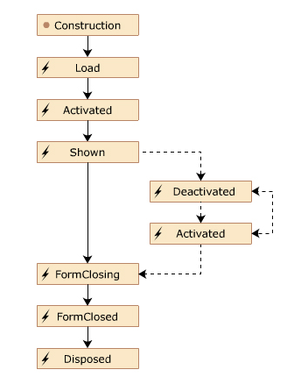
Life Cycle
Windows Form

Slide 5
Controls
Label
TextBox
Button
ListBox
ComBobox
LinkLabel
Windows Form

Slide 6
Label Controls
Properties:
1. lblName.Text = "Name";
Windows Form

Slide 7
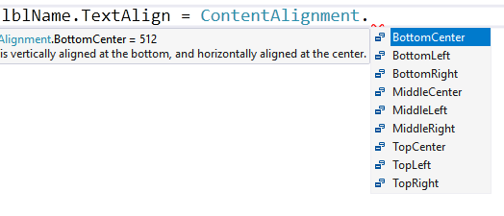
Label Controls
Properties:
2. lblName.TextAlign = ContentAlignment.BottomCenter;
Windows Form

Slide 8
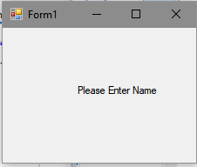
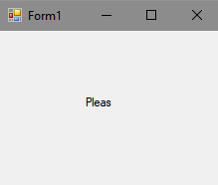
Label Controls
Properties:
3. lblName.AutoSize = ;
True
False
Windows Form

Slide 9
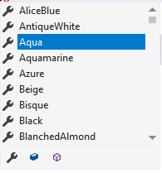
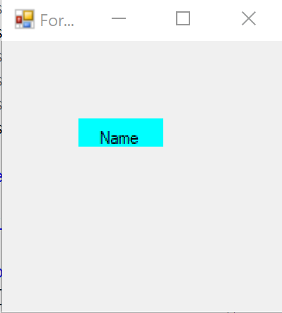
Label Controls
Properties:
4. lblName.BackColor = Color.Aqua;
Windows Form

Slide 10
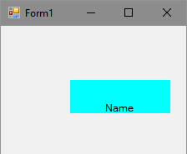
Label Controls
Properties:
5. lblName.Size = new Size(120, 40);
lblName.Width = 120;
lblName.Height = 40;
Windows Form

Slide 11
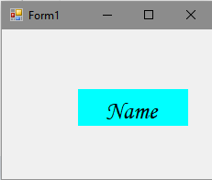
Label Controls
Properties:
6. lblName.Font = new Font("Monotype Corsiva", 20.0F);
Windows Form

Slide 12

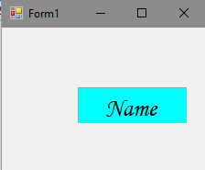
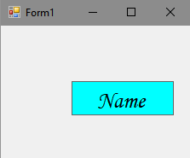
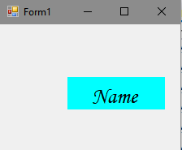
Label Controls
Properties:
7. lblName.BorderStyle = BorderStyle.Fixed3D;
Windows Form
Fixed3D
FixedSingle
None

Slide 13
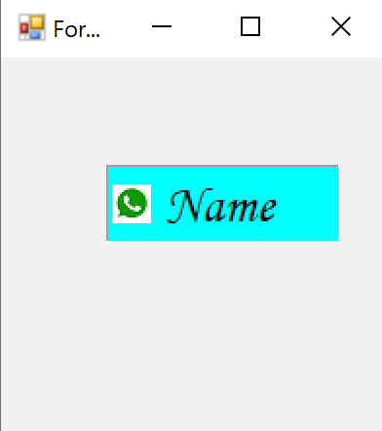
Label Controls
Properties:
8. Image img1 = Image.FromFile(@"Whatsapp.png");
lblName.Image = img1;
lblName.ImageAlign = ContentAlignment.MiddleLeft;
lblName.TextAlign = ContentAlignment.MiddleCenter;
Windows Form

Slide 14
Label Controls
Properties:
9. Image img1 = Image.FromFile(@"Whatsapp.png");
Image imgSearch = Image.FromFile(@"Search.png");
ImageList lst = new ImageList();
lst.Images.Add("Search",imgSearch);
lst.Images.Add("WhatsApp", imgWhatsapp);
lblName.ImageList =lst;
lblName.ImageIndex = 0;
Windows Form

Slide 15
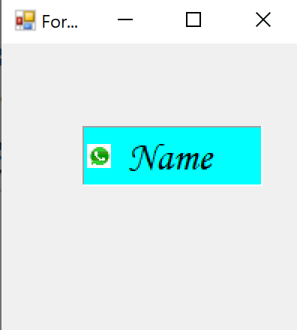
Label Controls
Properties:
10. Icon iconSave = new Icon(@"Untitled-1.ico");
lst.Images.Add(iconSave);
lblName.ImageIndex = 2;
Windows Form

Slide 16
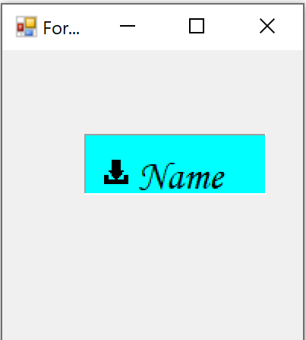
Label Controls
Properties:
11. lblName.Padding = new Padding(10, 10, 0, 0);
Windows Form

Slide 17
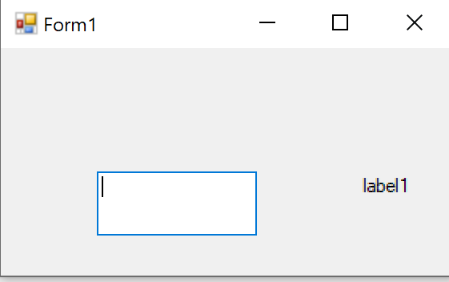
TextBox Controls
Properties:
1. txtName.Size = new Size(120, 40);
txtName.Multiline = true;//if true, one or more lines are allowed
Windows Form

Slide 18
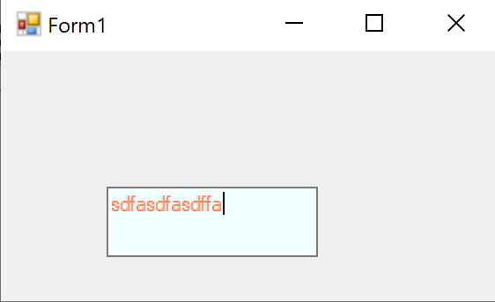
TextBox Controls
Properties:
2. txtName.BackColor = Color.Azure;
txtName.ForeColor = Color.Coral;
Windows Form

Slide 19
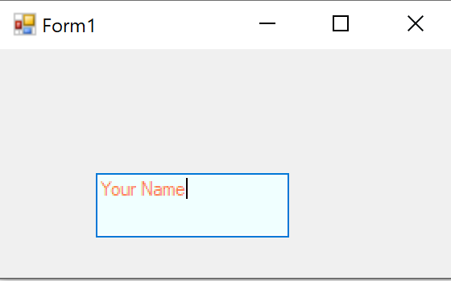
TextBox Controls
Properties:
3. txtName.Text = "Your Name";
Windows Form

Slide 20
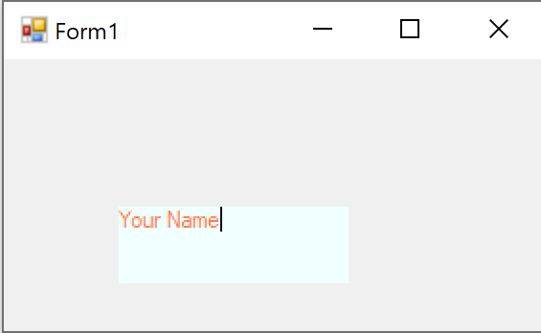
TextBox Controls
Properties:
4. txtName.BorderStyle = BorderStyle.None;
Windows Form

Slide 21
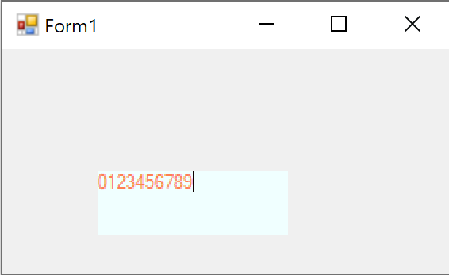
TextBox Controls
Properties:
5. txtName.MaxLength = 10;
Windows Form

Slide 22
TextBox Controls
Properties:
6. txtName.ReadOnly = true;
Windows Form

Slide 23
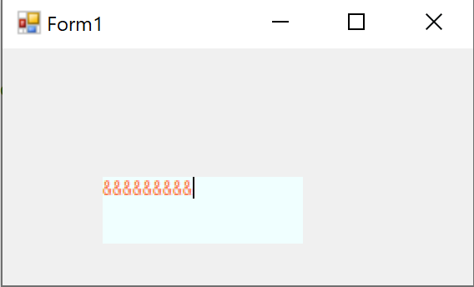
TextBox Controls
Properties:
7. txtName.PasswordChar = '&';
Windows Form

Slide 24
TextBox Controls
Events:
1. KeyDown, KeyPress, KeyUp
Windows Form
private void txtName_KeyDown(object sender, KeyEventArgs e)
{
lblDown.Text = txtName.Text + " -- " + e.KeyData.ToString();
}
private void txtName_KeyPress(object sender, KeyPressEventArgs e)
{
lblPress.Text = txtName.Text +" -- "+ e.KeyChar;
}
private void txtName_KeyUp(object sender, KeyEventArgs e)
{
lblUp.Text = txtName.Text +" -- "+e.KeyData.ToString();
}

Slide 25
Button Controls
Properties:
btnSave.Text = "Save";
btnSave.TextAlign = ContentAlignment.BottomCenter;
btnSave.ImageList = lst;
btnSave.ImageIndex = 2;
btnSave.ImageAlign = ContentAlignment.MiddleLeft;
btnSave.ForeColor = Color.AliceBlue;
btnSave.BackColor = Color.BurlyWood;
btnSave.Font = new Font("Monotype Corsiva", 20.0F);
btnSave.Size = new Size(100, 40);
btnSave.Padding = new Padding(10, 0, 0, 0);
Windows Form

Slide 26
Button Controls
Events:
Event | Description
Click | Occurs when a Button is clicked.
MouseEnter | Occurs when the mouse pointer enters the bounds of this element.
MouseLeave | Occurs when the mouse pointer leaves the bounds of this element.
MouseLeftButtonDown | Occurs when the left mouse button is pressed while the mouse pointer is over this element.
MouseLeftButtonUp | Occurs when the left mouse button is released while the mouse pointer is over this element.
MouseMove | Occurs when the mouse pointer moves while over this element.
MouseRightButtonDown | Occurs when the right mouse button is pressed while the mouse pointer is over this element.
MouseRightButtonUp | Occurs when the right mouse button is released while the mouse pointer is over this element.
Windows Form

Slide 27
Dialog Box
FolderBrowserDialog
OpenFileDialog
ColorDialog
FontDialog
SaveDialog
Windows Form

Slide 28
Dialog Box
There are many built-in dialog boxes to be used in Windows forms for various tasks like opening and saving files, printing a page, providing choices for colors, fonts, page setup, etc…
The ShowDialog method is used to display all the dialog box controls at run-time. It returns a value of the type of DialogResult enumeration. The values of DialogResult enumeration are −
Windows Form
OK
returns DialogResult.OK, when user clicks an OK button
Cancel
returns DialogResult.Cancel, when user clicks a Cancel button.
Ignore
returns DialogResult.Ignore, when user clicks an Ignore button.
No
returns DialogResult.No, when user clicks a No button.
Yes
returns DialogResult.Yes, when user clicks an Yes button

Slide 29
OpenFileDialog
Property | Description
AddExtension | Gets or sets a value indicating whether the dialog box automatically adds an extension to a file name if the user omits the extension.
DefaultExt | Gets or sets the default file name extension.
CheckFileExists | Gets or sets a value indicating whether the dialog box displays a warning if the user specifies a file name that does not exist.
CheckPathExists | Gets or sets a value indicating whether the dialog box displays a warning if the user specifies a path that does not exist.
Windows Form

Slide 30
OpenFileDialog
Property | Description
DereferenceLinks | Gets or sets a value indicating whether the dialog box returns the location of the file referenced by the shortcut or whether it returns the location of the shortcut (.lnk).
FileName | Gets or sets a string containing the file name selected in the file dialog box.
FileNames | Gets the file names of all selected files in the dialog box.
Multiselect | Gets or sets a value indicating whether the dialog box allows multiple files to be selected.
Title | Gets or sets the file dialog box title.
Windows Form

Slide 31
OpenFileDialog
Property | Description
Filter | Gets or sets the current file name filter string, which determines the choices that appear in the "Save as file type" or "Files of type" box in the dialog box.
FilterIndex | Gets or sets the index of the filter currently selected in the file dialog box.
SupportMultiDottedExtensions | Gets or sets whether the dialog box supports displaying and saving files that have multiple file name extensions.
InitialDirectory | Gets or sets the initial directory displayed by the file dialog box.
ReadOnlyChecked | Gets or sets a value indicating whether the read-only check box is selected.
Windows Form

Slide 32
OpenFileDialog
Property | Description
SafeFileName | Gets the file name and extension for the file selected in the dialog box. The file name does not include the path.
SafeFileNames | Gets an array of file names and extensions for all the selected files in the dialog box. The file names do not include the path.
ShowHelp | Gets or sets a value indicating whether the Help button is displayed in the file dialog box.
ShowReadOnly | Gets or sets a value indicating whether the dialog box contains a read-only check box.
RestoreDirectory | Gets or sets a value indicating whether the dialog box restores the current directory before closing.
Windows Form

Slide 33
OpenFileDialog
openFileDialog1.Title = "Select Your File";
openFileDialog1.Filter = "Text(*.txt)|*.txt|All Files(*.*)|*.*";
openFileDialog1.InitialDirectory = @"C:\Users";
if(openFileDialog1.ShowDialog()==DialogResult.OK)
{
string file = openFileDialog1.FileName;
lblFileName.Text = openFileDialog1.SafeFileName;
////Option 1:
//StreamReader reader = new StreamReader(file);
//txtFile.Text = reader.ReadToEnd();
//reader.Dispose();
//Option 2:
txtFile.Text = File.ReadAllText(file);
}
Windows Form

Slide 34
SaveFileDialog
Property | Description
CreatePrompt | Gets or sets a value indicating whether the dialog box prompts the user for permission to create a file if the user specifies a file that does not exist.
AddExtension | Gets or sets a value indicating whether the dialog box automatically adds an extension to a file name if the user omits the extension.
DefaultExt | Gets or sets the default file name extension.
CheckFileExists | Gets or sets a value indicating whether the dialog box displays a warning if the user specifies a file name that does not exist.
CheckPathExists | Gets or sets a value indicating whether the dialog box displays a warning if the user specifies a path that does not exist.
Windows Form

Slide 35
SaveFileDialog
Property | Description
DereferenceLinks | Gets or sets a value indicating whether the dialog box returns the location of the file referenced by the shortcut or whether it returns the location of the shortcut (.lnk).
FileName | Gets or sets a string containing the file name selected in the file dialog box.
FileNames | Gets the file names of all selected files in the dialog box.
Title | Gets or sets the file dialog box title.
Windows Form

Slide 36
SaveFileDialog
Property | Description
Filter | Gets or sets the current file name filter string, which determines the choices that appear in the "Save as file type" or "Files of type" box in the dialog box.
FilterIndex | Gets or sets the index of the filter currently selected in the file dialog box.
SupportMultiDottedExtensions | Gets or sets whether the dialog box supports displaying and saving files that have multiple file name extensions.
InitialDirectory | Gets or sets the initial directory displayed by the file dialog box.
Windows Form

Slide 37
SaveFileDialog
Property | Description
ShowHelp | Gets or sets a value indicating whether the Help button is displayed in the file dialog box.
RestoreDirectory | Gets or sets a value indicating whether the dialog box restores the current directory before closing.
Windows Form

Slide 38
SaveFileDialog
saveFileDialog1.Filter = "Text(*.txt)|*.txt";
saveFileDialog1.InitialDirectory = @"C:\Users\CRP\Desktop";
if (saveFileDialog1.ShowDialog() == DialogResult.OK)
{
Stream s = File.Open(saveFileDialog1.FileName, FileMode.OpenOrCreate);
using (s)
{
using (StreamWriter sw = new StreamWriter(s))
{
sw.Write(txtBox.Text);
}
}
}
Windows Form

Slide 39
FontDialog
Property | Description
AllowSimulations | Gets or sets a value indicating whether the dialog box allows graphics device interface (GDI) font simulations.
Color | Gets or sets the selected font color.
Font | Gets or sets the selected font.
FontMustExist | Gets or sets a value indicating whether the dialog box specifies an error condition if the user attempts to select a font or style that does not exist.
MaxSize | Gets or sets the maximum point size a user can select.
Windows Form

Slide 40
FontDialog
Property | Description
MinSize | Gets or sets the minimum point size a user can select.
ShowApply | Gets or sets a value indicating whether the dialog box contains an Apply button
ShowColor | Gets or sets a value indicating whether the dialog box displays the color choice.
ShowEffects | Gets or sets a value indicating whether the dialog box contains controls that allow the user to specify strikethrough, underline, and text color options.
ShowHelp | Gets or sets a value indicating whether the dialog box displays a Help button.
Windows Form

Slide 41
FontDialog
DialogResult result = fontDialog1.ShowDialog();
if(result == DialogResult.OK)
{
//txtBox.Font = fontDialog1.Font;
txtBox.SelectionFont = fontDialog1.Font;
}
Windows Form

Slide 42
ColorDialog
Property | Description
AllowFullOpen | Gets or sets a value indicating whether the user can use the dialog box to define custom colors.
Color | Gets or sets the color selected by the user.
FullOpen | Gets or sets a value indicating whether the controls used to create custom colors are visible when the dialog box is opened.
Windows Form

Slide 43
ColorDialog
DialogResult result = colorDialog1.ShowDialog();
if (result == DialogResult.OK)
{
txtBox.ForeColor = colorDialog1.Color;
}
Windows Form

Slide 44
FolderBrowserDialog
Property | Description
RootFolder | The RootFolder is where the dialog first begins. This is the initial folder.
SelectedPath | The folder that was selected when the dialog was exited. You can test the DialogResult first and then access this property.
ShowNewFolderButton: | Whether the new folder button should be visible.
Windows Form

Slide 45
FolderBrowserDialog
DialogResult result = folderBrowserDialog1.ShowDialog();
if(result == DialogResult.OK)
{
txtPath.Text = folderBrowserDialog1.SelectedPath;
}
Windows Form

Slide 46
Check Box
Property | Description
Appearance | Gets or sets a value determining the appearance of the check box.
AutoCheck | Gets or sets a value indicating whether the Checked or CheckedState value and the appearance of the control automatically change when the check box is selected.
CheckAlign | Gets or sets the horizontal and vertical alignment of the check mark on the check box.
Checked | Gets or sets a value indicating whether the check box is selected.
Text | Gets or sets the caption of a check box.
Windows Form

Slide 47
Radio Button
Property | Description
Appearance | Gets or sets a value determining the appearance of the check box.
AutoCheck | Gets or sets a value indicating whether the Checked or CheckedState value and the appearance of the control automatically change when the check box is selected.
CheckAlign | Gets or sets the horizontal and vertical alignment of the check mark on the check box.
Checked | Gets or sets a value indicating whether the check box is selected.
Text | Gets or sets the caption of a check box.
Windows Form

